Slide 1
Reservation of Dormitory Rooms
Welcome to Group 4 presentation

Slide 2
Introduction
22 November 2016 assignment
Project about the Reservation of Dormitory Rooms

Slide 3
Content:
Background
Statements
Description about the project
Benefits
Methods or Approach

Slide 4
Background
Booking room for dormitory require to go to the office
Cost a lot in both money and strength
Some have no opportunity to visit the dormitory
=> We need a system to solve this problem

Slide 5
Statements
Allows students to easily access and book the suitable room
Provides students and their parents a good overview about the dormitory

Slide 6
Description
Give students an opportunity to reserve the room which will meet student’s needs
Provides students a quick access to the information about things that is related to the dormitory
Gives good tips for freshmen

Slide 7
Benefits
Administrator can easily manage the booking system
The second advantage is the website will provide students all information that they need about the dormitory

Slide 8
Approach
On 23-24 November 2016, identify the material needed
On 27-28 November 2016, finish the homepage
On 29 November 2016, finish the Dormitory Review section
On 30 November 2016, finish the Location section
On 1-3 December 2016, finish the Booking system
On 4 December 2016, finish the Contact tag and feedback system

Slide 9
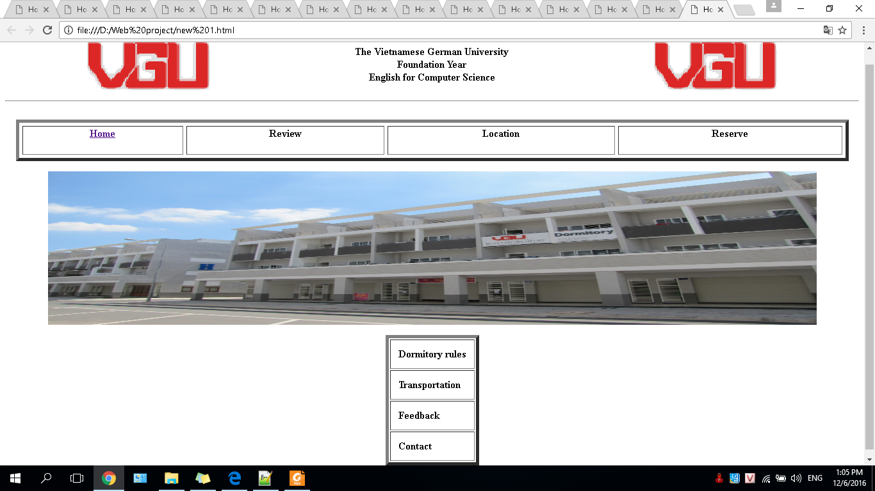

Slide 10
Approach
On 19-20 December 2016, identify the material needed
On 22-23 December 2016, finish the homepage
On 25 December 2016, finish the Dormitory Review section
On 27 December 2016, finish the Location section
On 28 December 2016, finish the Booking system
On 29-30 December 2016, finish the Contact tag and feedback system

Slide 11
Conclusion
This website offers students a lot of opportunity to reserve a room without moving away from their home.
Furthermore, it gives students a full overview about the dormitory area from their home.
Telephone 01227658105 or email cs2016_nhu.pk@student.vgu.edu.com

